Slide 1
MRI of Infiltrative Diseases of the Liver: How do I evaluate Iron, Fat and Fibrosis?
Nadia Caplan MD MSc
Hadassah-Hebrew University Medical Center, Jerusalem, Israel
Notes:
Answer : D

Slide 2
How do we assess IRON?
On CT, hyperdense liver can be due to iron overload, as well as long term treatment with amiodarone, glycogen deposition, copper overload in Wilson disease

Slide 3
How do we assess IRON?
Normal liver parenchyma is hyperintense to muscle.
A liver hypointense to the muscle indicates a liver iron overload.

Slide 4
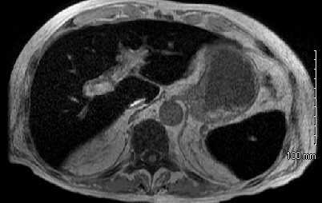
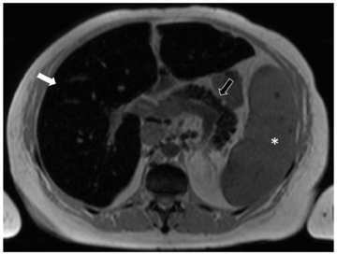
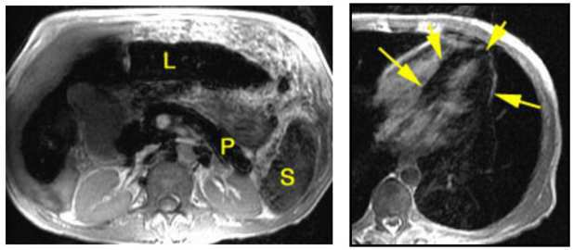
HemoSiderosis HemoCHromatosis
Aquired (multiple transfusions)
Reticuloendotelial system: Spleen, liver, bone marrow, lymph nodes
T1 and T2 dark due to susceptibility effect
Drop of signal on in-phase
Hereditary (CHromosome)
Liver, pancreas, myocard
T1 and T2 dark due to susceptibility effect
Drop of signal on in-phase

Slide 5
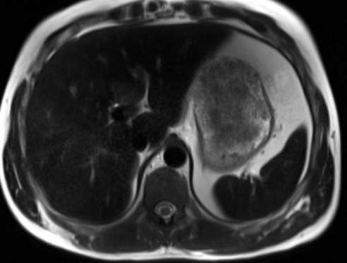
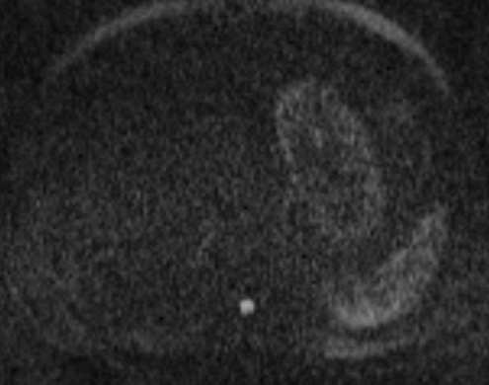
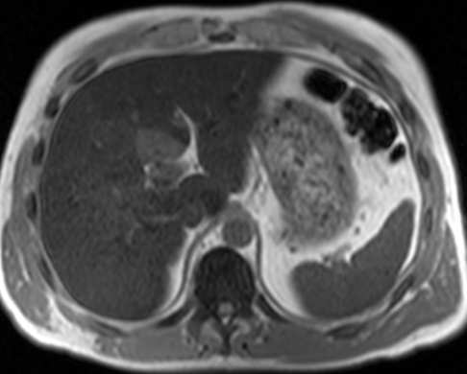
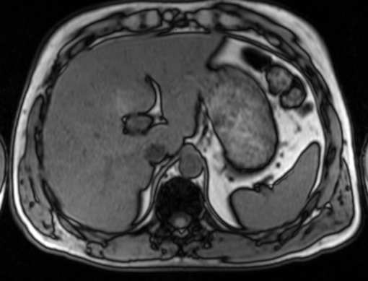
The superparamagnetic properties of iron cause decrease of T2 and T1 relaxation times of the liver, which leads to a decrease in signal intensity
Notes:
hemosiderosis

Slide 6
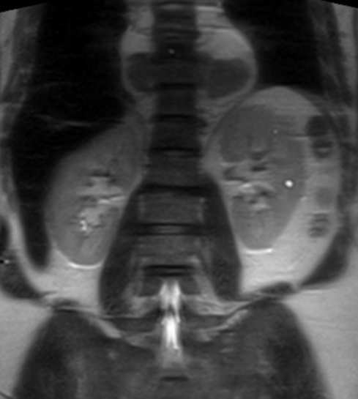
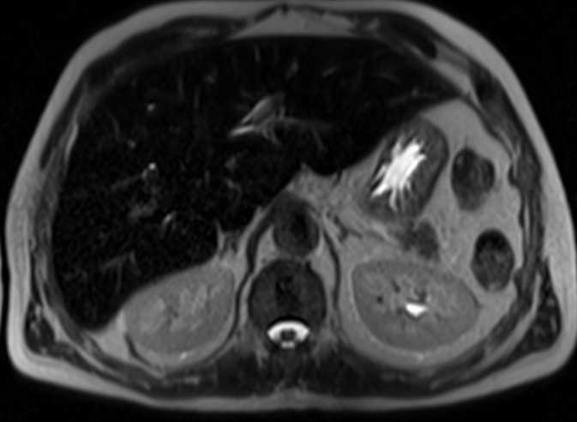
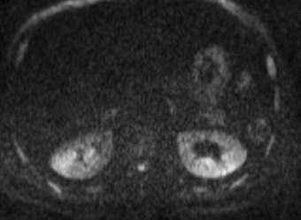
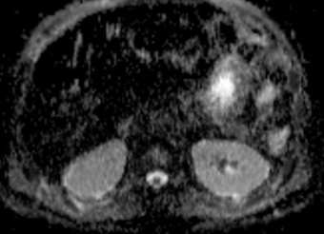
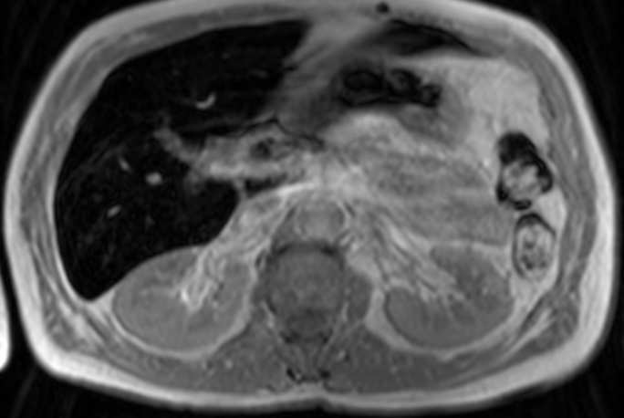
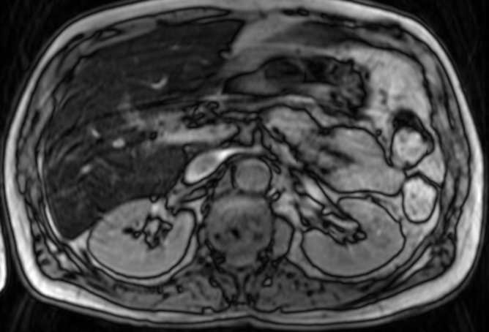
Notes:
Hemosiderosis, thalassemia

Slide 7
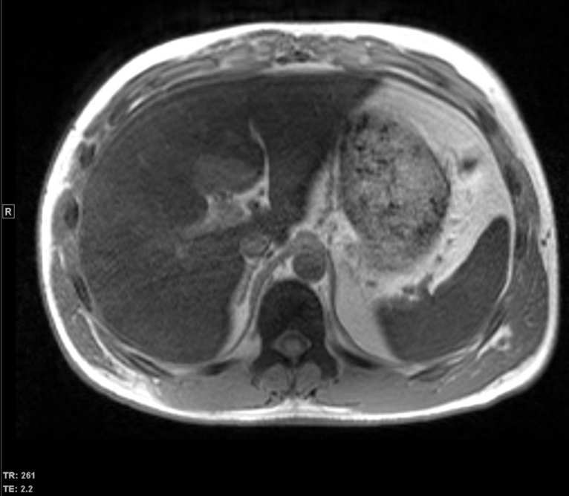
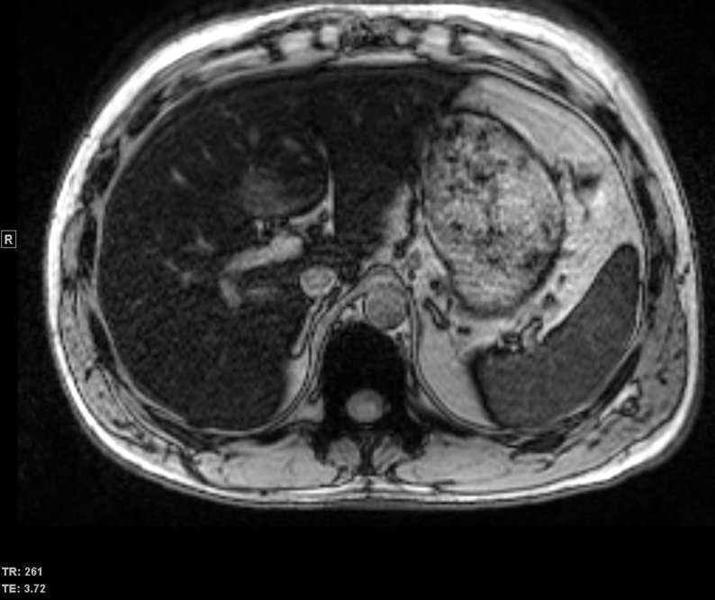
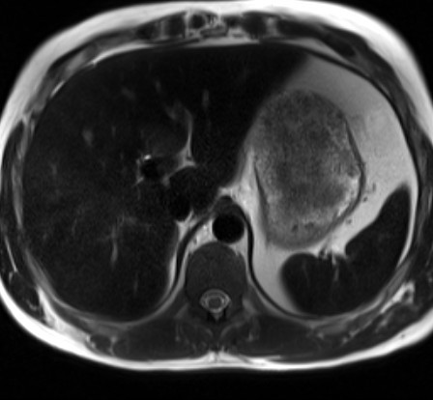
Notes:
Hemosiderosis - pitfall

Slide 8
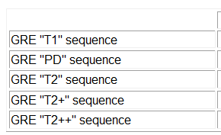
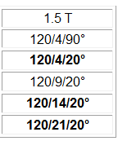
How do we QUANTIFY IRON on MRI?
Gradient echo sequences are more sensitive than others to magnetic susceptibility
sensitivity

Slide 9
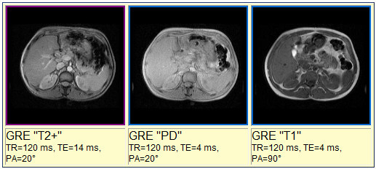
Normal liver (LIC=20µmol/g, 1.5T)
Notes:
the liver is usually hyperintense to the muscle. A liver hypointense to the muscle indicates a liver iron overload.

Slide 10
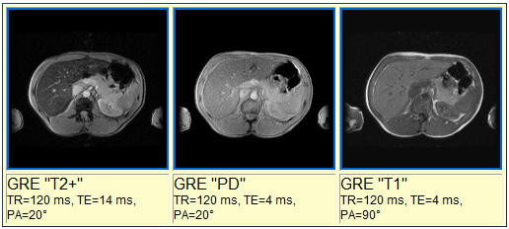
Slight overload (LIC= 40 - 100 µmol/g, 1.5T)
Notes:
In case of slight overload, liver signal intensity decrease can only be seen on T2-weighted gradient echo sequences. The liver is then hypointense to the muscle.

Slide 11
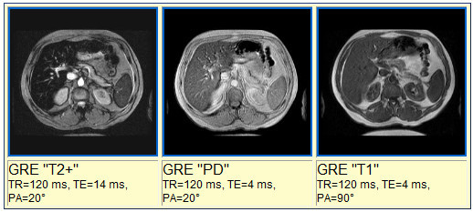
Moderate overload (LIC= 100 - 200 µmol/g, 1.5T)
Notes:
In case of moderate overload the decrease of the liver signal intensity is depicted on all sequence..

Slide 12
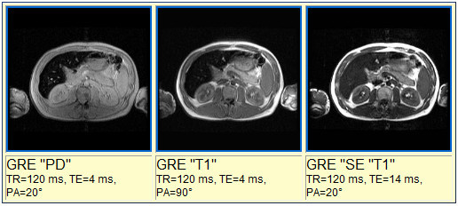
Major overload (LIC=350µmol/g, 1.5T)

Slide 13
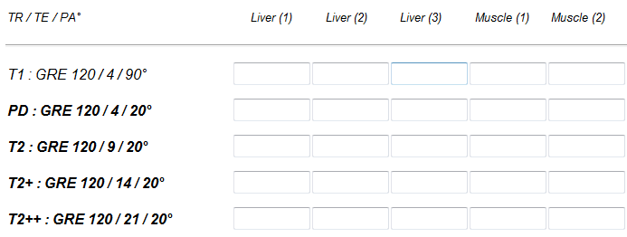

Slide 14
slight overload: 40 - 100 µmol/g
most sensitive MR sequences T* and T**
moderate overload: 100 - 200 µmol/g
Sensitive sequences (T2 and T2+) are saturated and underestimate the concentration.
Use less sensitive MR sequences T1 and PD
major overload: 200 µmol/g and up
Less sensitive sequences become also saturated when the LIC is above 300 µmol/g.

Slide 15
How do we assess FIBROSIS?

Slide 16
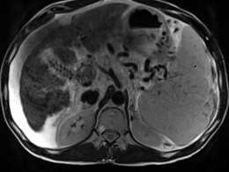
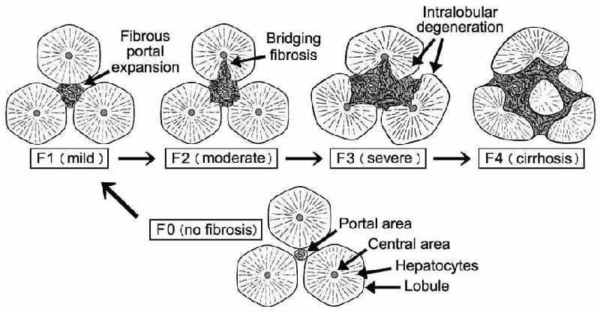
Viral
Alcohol
Drug induced
NASH
Hemosiderosis/ hemochromatosis
Wilson
Inborn storage diseases
Autoimmune
Parasitic
Sarcoidosis
Notes:
Active – multiple etiologies to chronic that looks the same

Slide 17
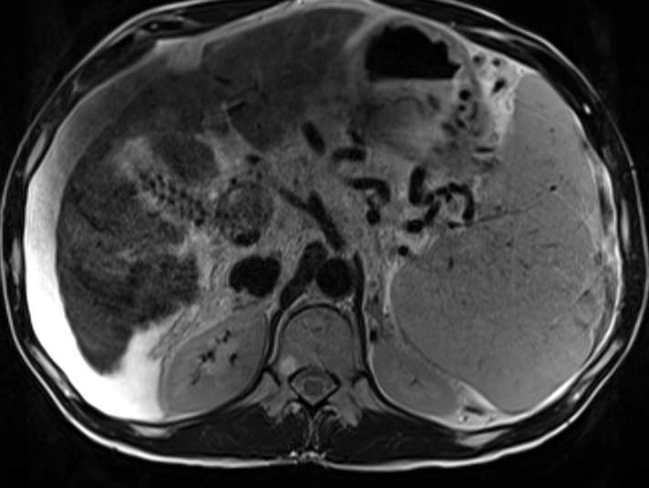
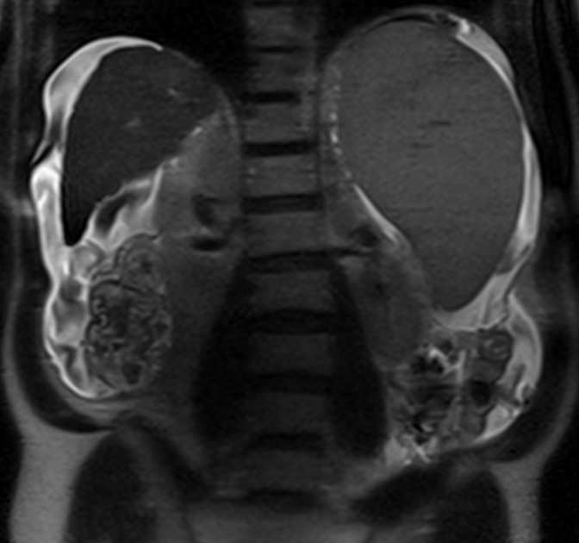
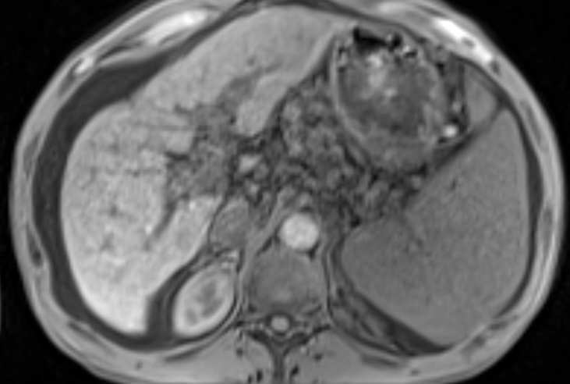
End stage cirrhosis
T2
T2
T1 FS
Notes:
We are all familiar with the appearance of cirrhotic liver : shrunken liver, nodular border, signs of portal HTN

Slide 18
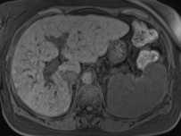
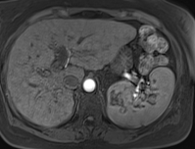
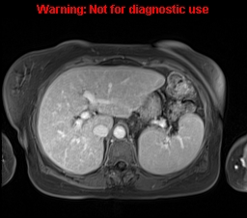
Notes:
Subtle Cirrhosis – fibrotic bands

Slide 19
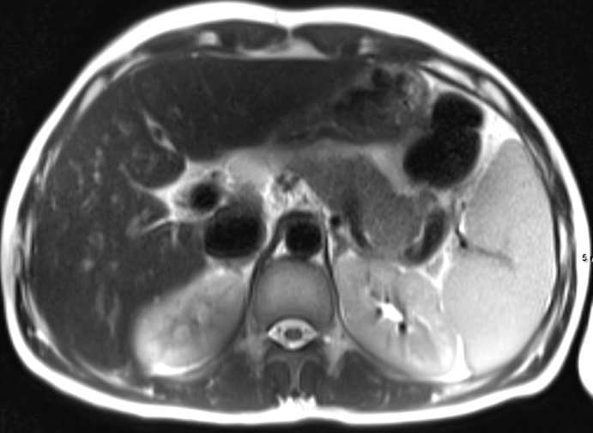
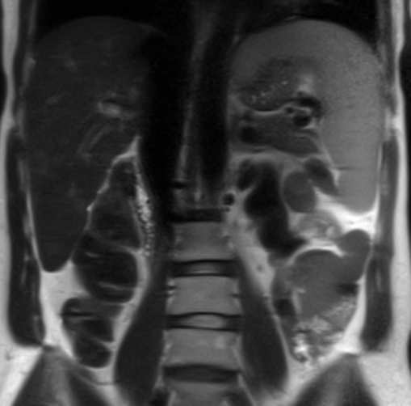
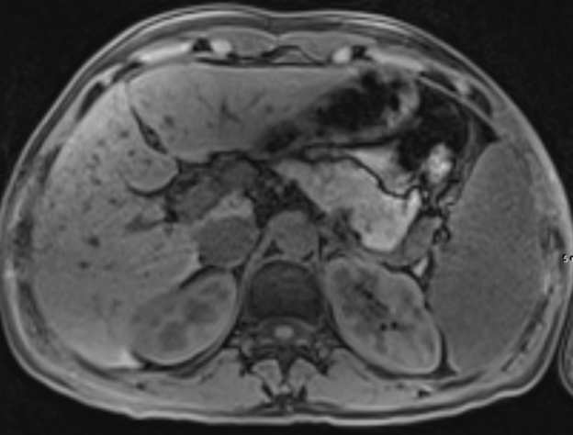
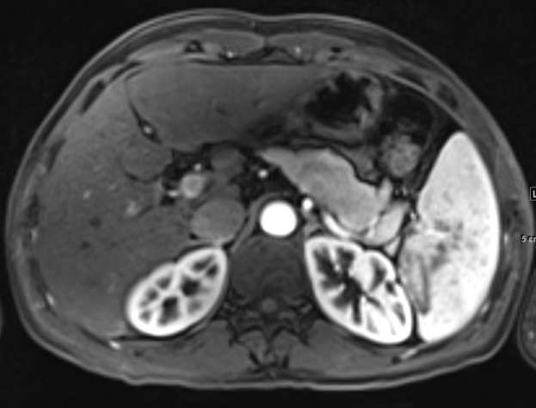
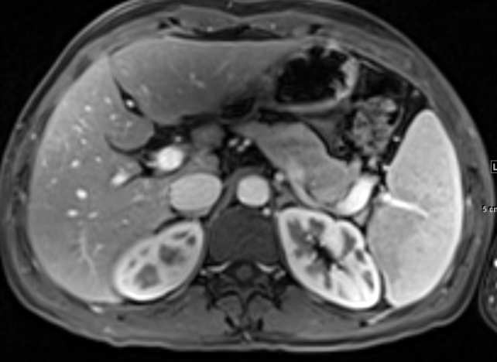
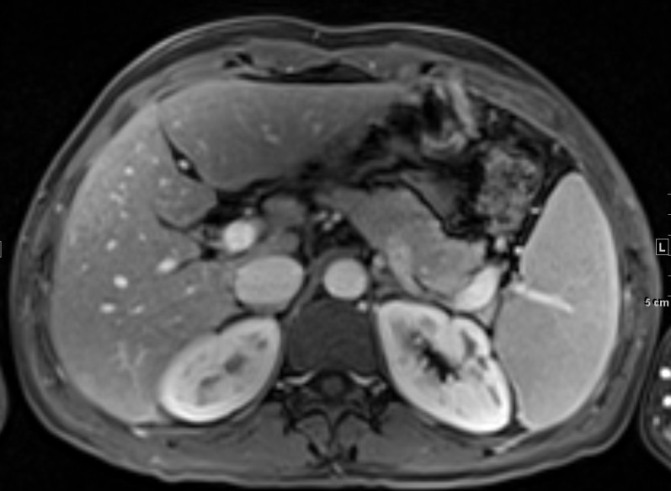
Notes:
Subtle fibrosis: nodularity, peripheralization of small vessels, dilated peri portal space, pointed posterior border
WILSON, SAME PATIENT 11/12/14, AFTER COPPER CHELATION THERAPY

Slide 20
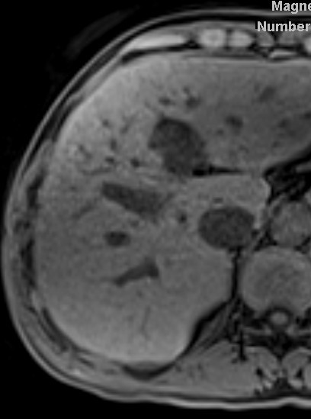
Notes:
Subtle cirrhosis – regenerative nodules (glycogen)

Slide 21
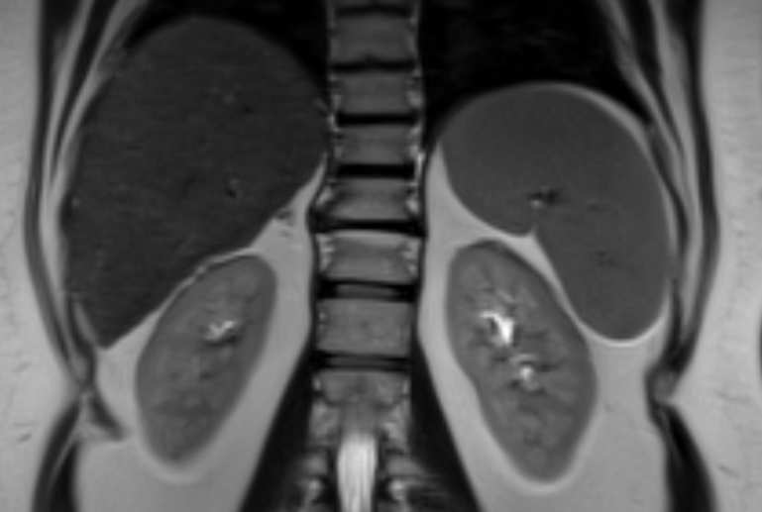
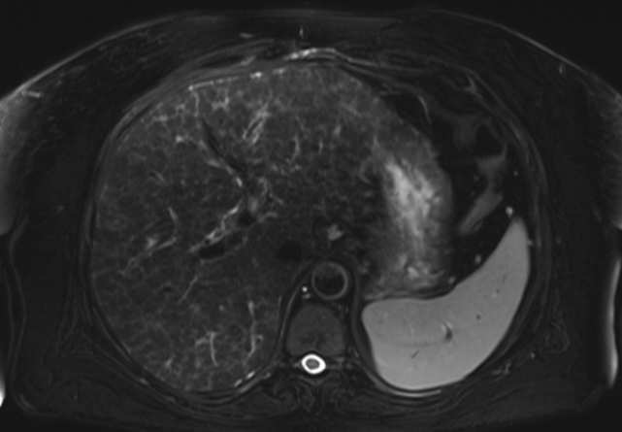
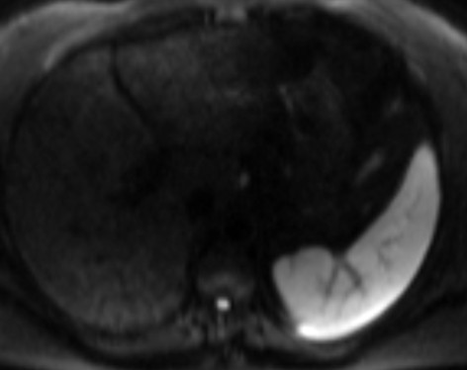
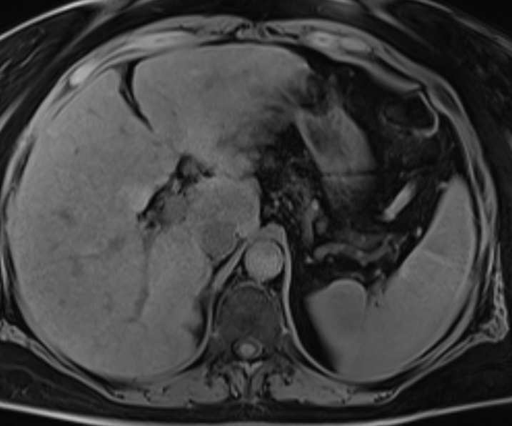
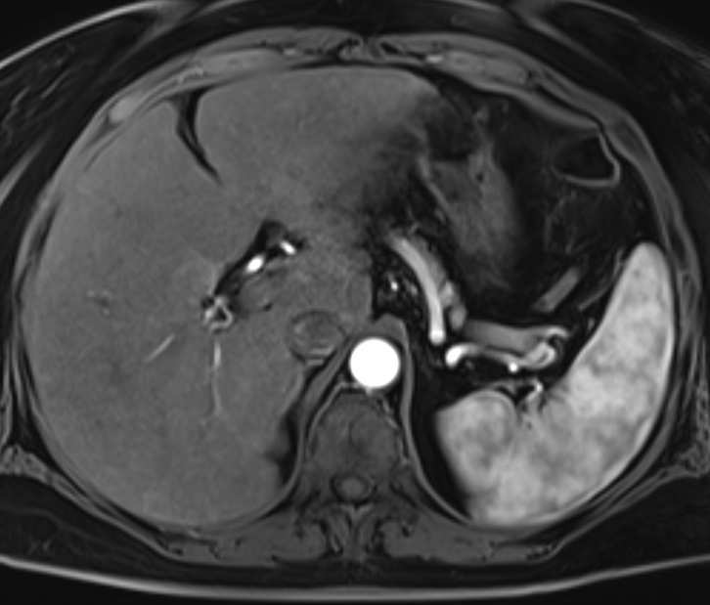
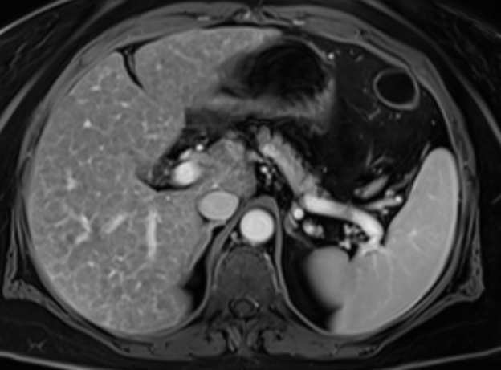
Notes:
Delayed Reticular enhancement

Slide 22
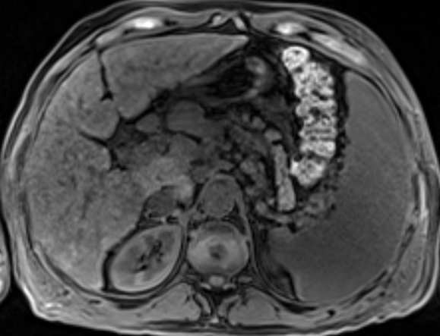
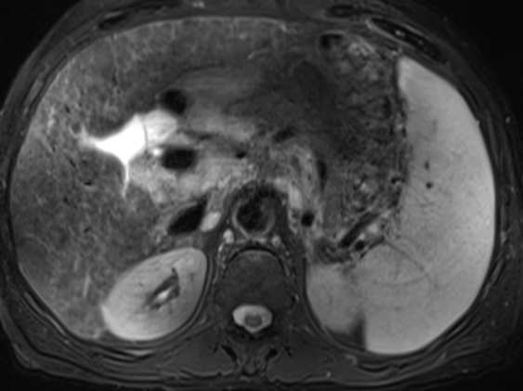
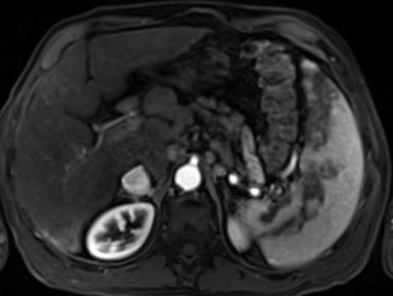
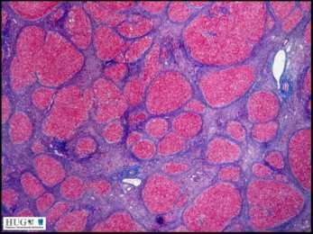
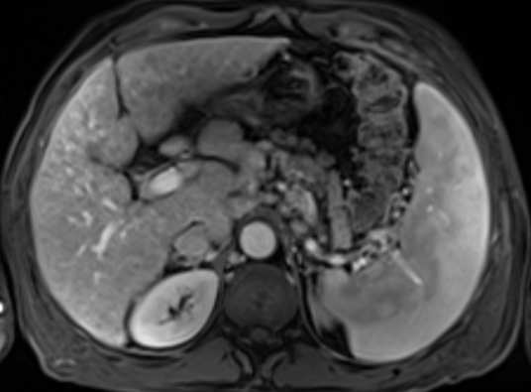
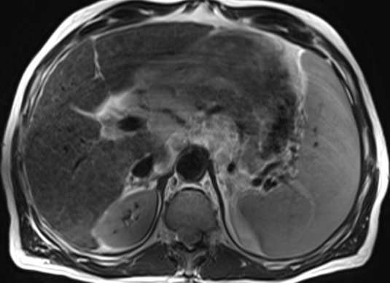
Notes:
RETICULAR FIBROTIC TISSUE

Slide 23
Notes:
Gamna gandi bodies

Slide 24
Early hepatic fibrosis
Early morphologic changes:
widening of periportal space and fissures
posterior “tail”
Regenerative nodules = T1 hyperintense (glycogen)
Peripheral volume loss = subcapsular crowded small vessels
Delayed reticular enhancement = fibrous septae
Extrahepatic changes
Increased stiffness on MR Elastography

Slide 25
MR Elastography
Assessment of Hepatic Fibrosis With Magnetic Resonance Elastography,
MENG YIN et al, CLINICAL GASTROENTEROLOGY AND HEPATOLOGY 2007;5:1207–1213

Slide 26
MR Elastography
Assessment of Hepatic Fibrosis With Magnetic Resonance Elastography,
MENG YIN et al, CLINICAL GASTROENTEROLOGY AND HEPATOLOGY 2007;5:1207–1213

Slide 27
MR Elastgraphy - limitations
Assessment of Hepatic Fibrosis With Magnetic Resonance Elastography,
MENG YIN et al, CLINICAL GASTROENTEROLOGY AND HEPATOLOGY 2007;5:1207–1213

Slide 28
MR Elastgraphy
Assessment of Hepatic Fibrosis With Magnetic Resonance Elastography,
MENG YIN et al, CLINICAL GASTROENTEROLOGY AND HEPATOLOGY 2007;5:1207–1213

Slide 29
MRE compared to Shear Wave Elastography
Hepatic Fibrosis: Prospective Comparison of MR Elastography and US Shear-Wave Elastography for Evaluation, Jeong Hee Yoon, MD et al, Radiology: Volume 273: Number 3—December 2014

Slide 30
How do we assess FAT?

Slide 32
Notes:
Severe steatosis 24%

Slide 33
Notes:
Focal fat. 25 yoF few months after sleeve gastrectomy

Slide 34
Notes:
Fatty infiltration with Focal fatty sparing
High T2
Reticulation on T2 and DWI
Reticular late enhancement

Slide 35
the accessory portal system of Sappey, branches of which pass in the round and falciform ligaments (particularly the latter) to unite with the epigastric and internal mammary veins, and through the diaphragmatic veins with the azygos
Veins of Sappey
Right gastric vein
Posterior duodenopancreatic vein

Slide 36
% steatosis calculation
(In – Out) / 2 * In
296 – 142 / 2* 296 = 0.26
26%
Notes:
Severe steatosis 24%

Slide 37
Hepatic steatosis / sparing
NASH, dietary change, malnutrition, severe hepatitis, steroid use, pregnancy, drug toxic effects, chemotherapy, storage diseases
Diffuse or focal steatosis or sparing
Relatively hyperintense on T2
Drop of signal on T1 out-of-phase
Vascular - veins of Sappey, aberrant right gastric vein or posterior duodenopancreatic vein

Slide 38
THANK YOU
תודה רבה
MERCI BEAUCOUP
MUCHAS GRACIAS
большое спасибо

